Slide 1

OIL PRICE PREDICTION
P310 Group-5
Karthik
15/NOV/23

Slide 2
Business Problem:
Oil is a product that goes completely in a different direction for a single market event as the oil prices are rarely based on real-time data, instead, it is driven by externalities making our attempt to forecast it even more challenging
As the economy will be highly affected by oil prices our model will help to understand the pattern in prices to help the customers and businesses to make smart decisions.
Objective:
The objective of the analysis is to predict the price of the oil and to emphasize the need for a reliable model that can understand price patterns. This model aims to help customers and businesses make smart decisions considering the significant impact of oil prices on the economy.

Slide 3
Project Architecture / Project Flow
Data Collection
Data Preprocessing
Feature Engineering
Train-Test Split
Model Selection
Model Training
Model Evaluation
Prediction
Forecast Visualization
Deployment

Slide 4
Exploratory Data Analysis (EDA) and
Feature Engineering

Slide 5
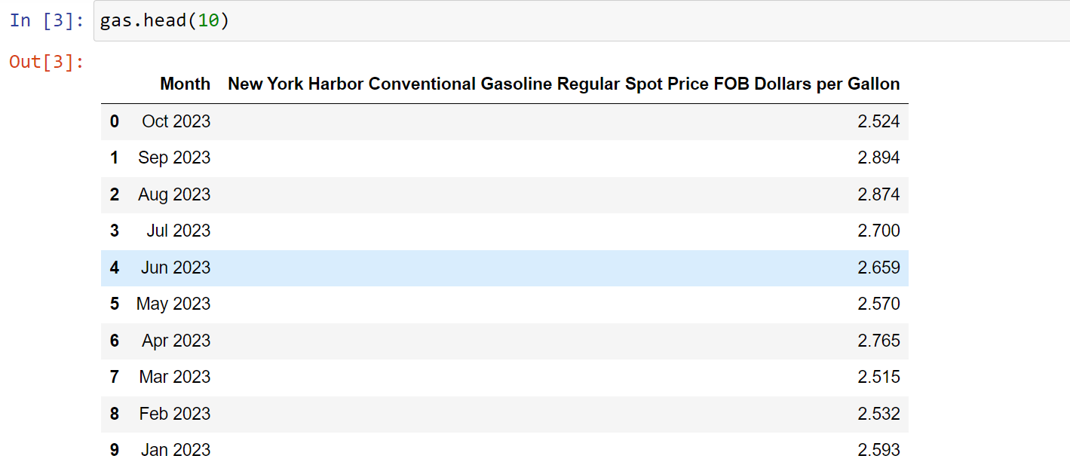
Dataset details
Our dataset contains 449 rows and 2 columns, First column describes about the timestamp and second column describes about the Dollars per gallon

Slide 6
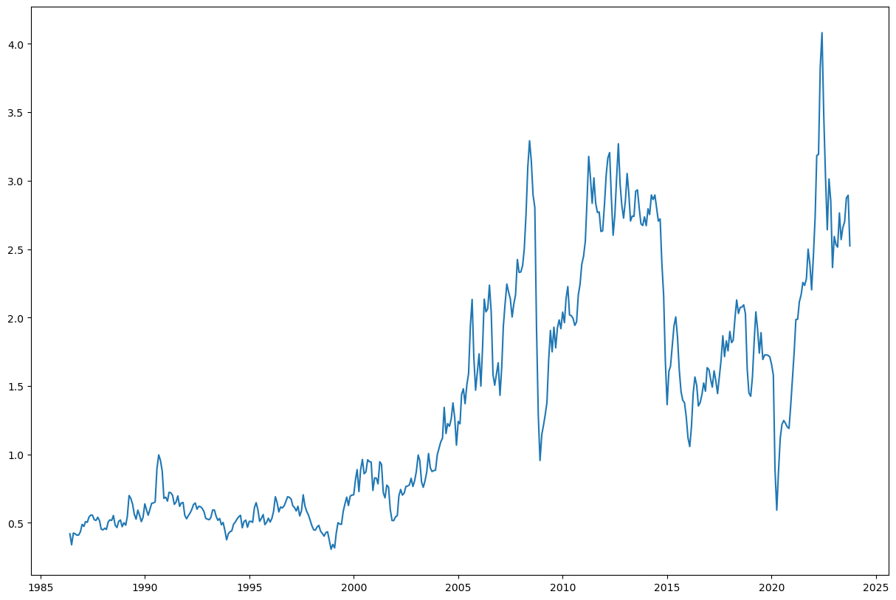
Exploratory Data Analysis (EDA)
If we observe the price of the gasoline over period of time, the upward trend started from the year 2002 we can say that vehicles are affordable to common people
Also the exponential nature of the oil price over the time can be observed due to inflation and various factors like Technological Advances, Global Economic Recession (2008) etc.,

Slide 7
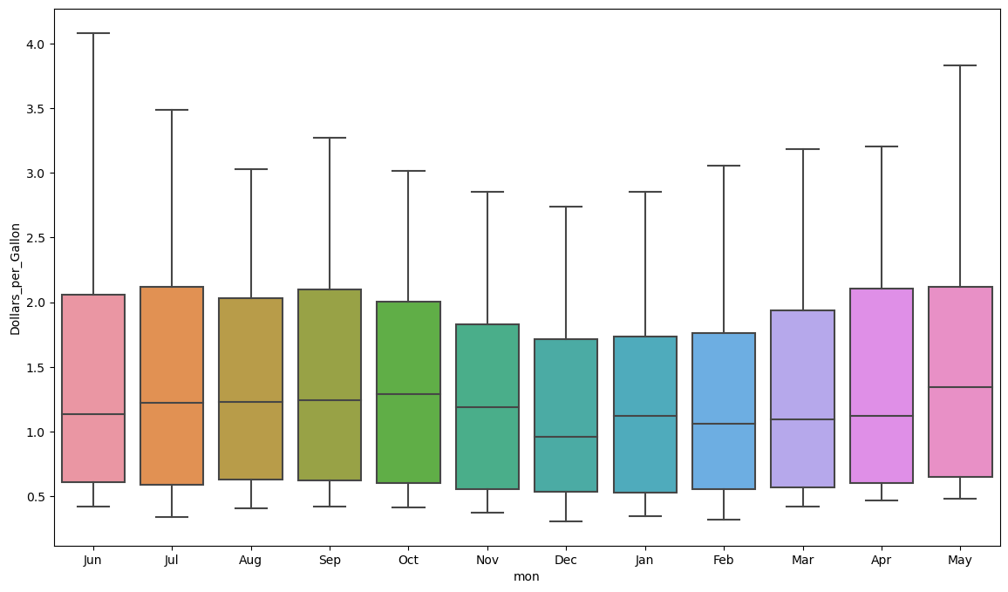
Exploratory Data Analysis (EDA)
Monthly Boxplot
If we observe the price ,we found it higher in June and May and lesser in the months of Dec, Jan and Feb
We can say that the price of gasoline is higher during summer season and lower in winter season
Because All oils, (Even synthetics) are a complex mixture of hydrocarbons. During summer season in the hot environment of the engine, a small amount of some of the components will slowly evaporate

Slide 8
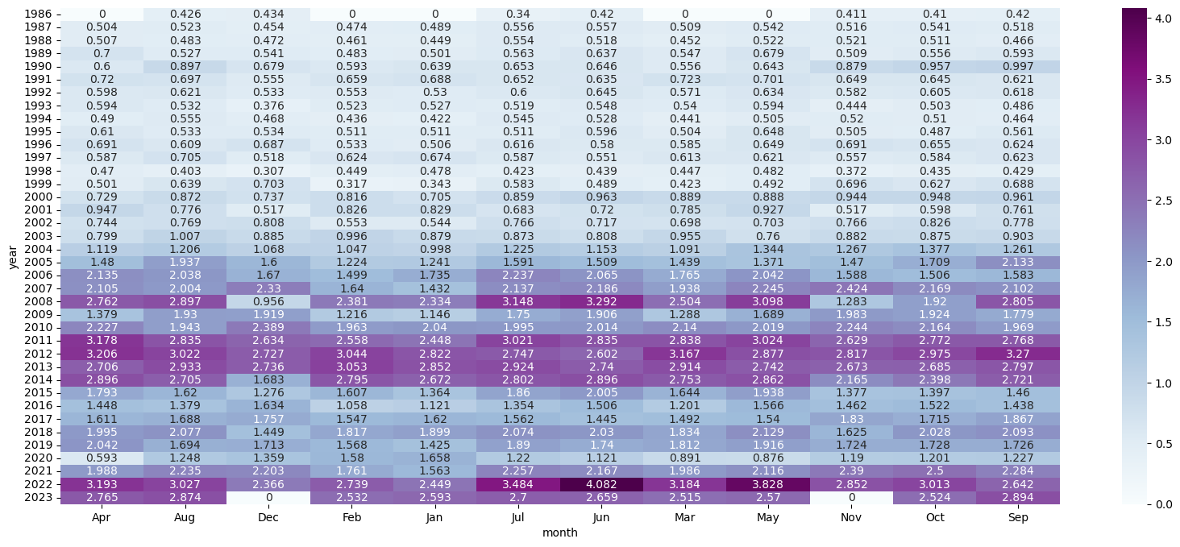
we can observe all the values with lighter shades are represents lower mean And the values which are in darker shades are represents higher mean
Exploratory Data Analysis (EDA)
Heatmap for analyzing price by their ‘mean’
As we can observe the prices are started increasing in the year 2005-06
Because before 2005 vehicles are not affordable by common man so the prices of oil were also less
But now we can see increase in price much higher
In 2022 the price got highest in June , it’s affected may be because of consequences of covid-19 pandemic

Slide 9
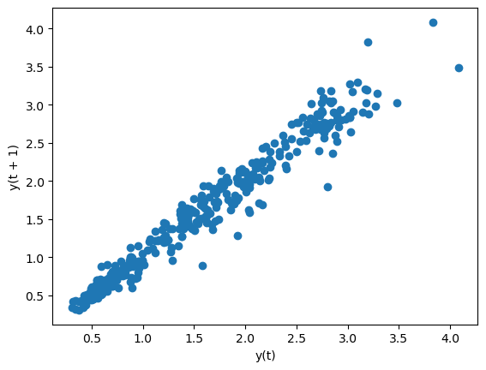
Exploratory Data Analysis (EDA)
LAG PLOT
Here we can observe a good correlation between the lagged version of the oil price

Slide 10
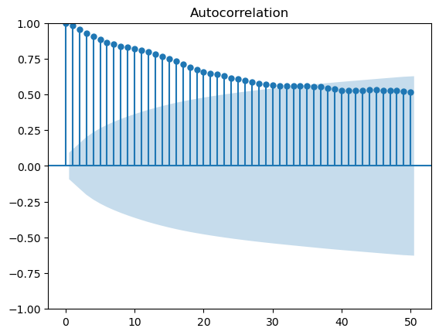
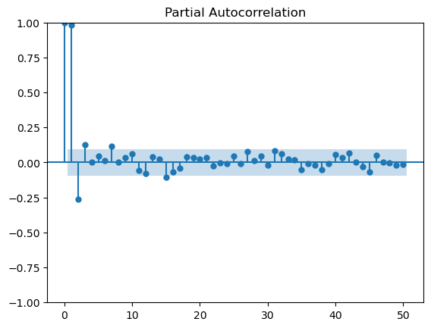
Exploratory Data Analysis (EDA)
ACF & PACF PLOTS
We can observe that ACF plot is having a gradual decrease with its consecutive lagged versions and PACF plot is having sharp cutoff after its second lagged version
We can hence conclude that a Moving Average Model will help giving better results

Slide 11
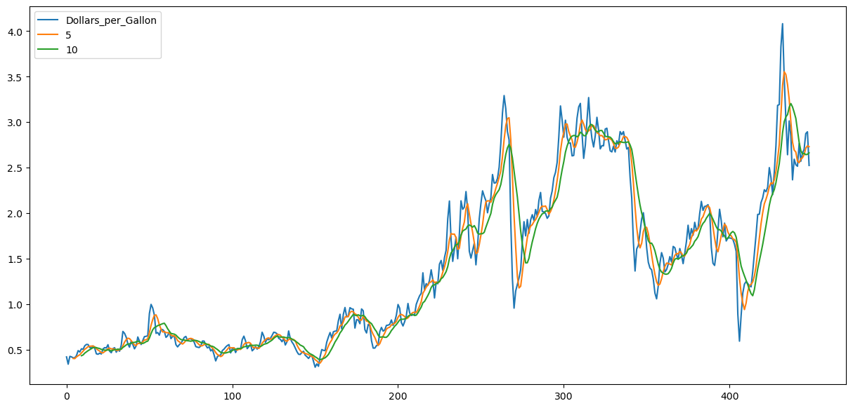
Exploratory Data Analysis (EDA)
ROLLING STATS - MOVING AVERAGES
We are using moving averages to smoothen the time series and here we have moving average at window of 5 and 10 with the original curve.

Slide 12
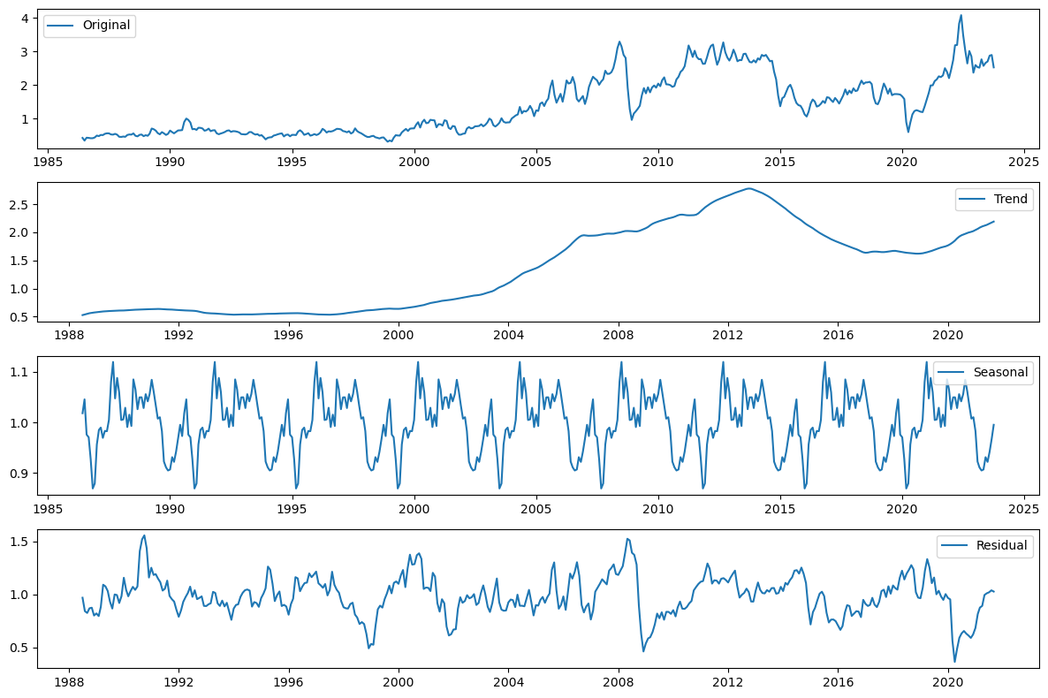
Exploratory Data Analysis (EDA)
SEASONAL DECOMPOSITION
As we can see that there is change in amplitude of the seasonal component with respect to the trend.
In the Seasonal graph, we can see that there is a pattern being repeated once in every 5 years.

Slide 13
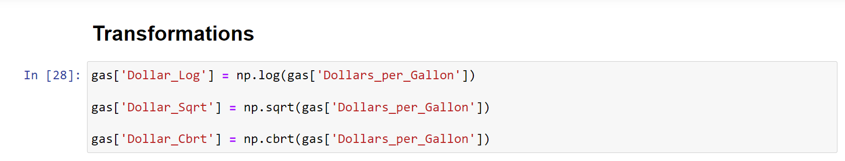
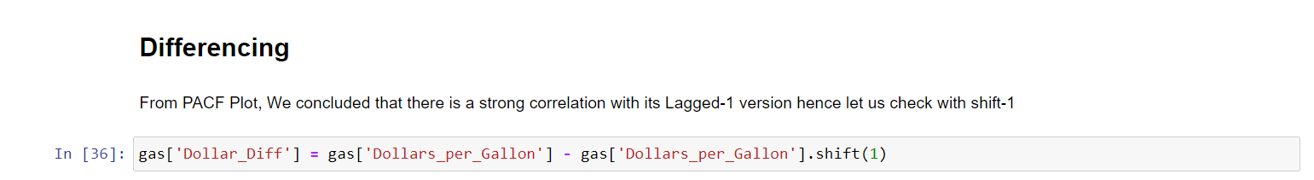
Feature Engineering
After performing ADF test result, the time series data turned out to be non-stationary, which implies that either there is no constant mean or variance
So we have used some techniques to convert to stationary time series
Transformations
Differencing

Slide 14
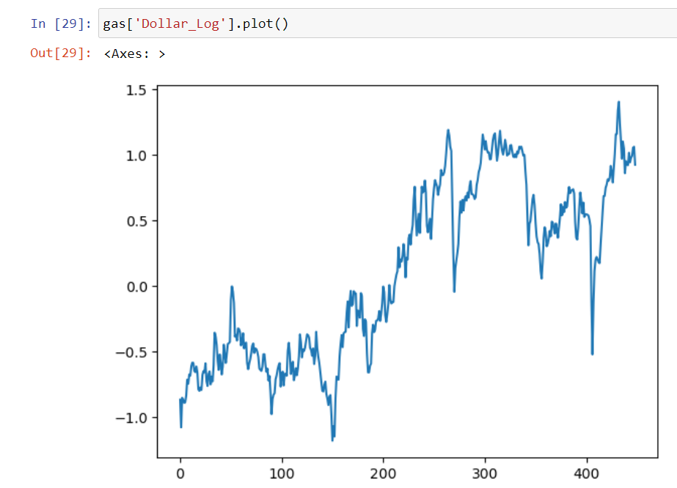
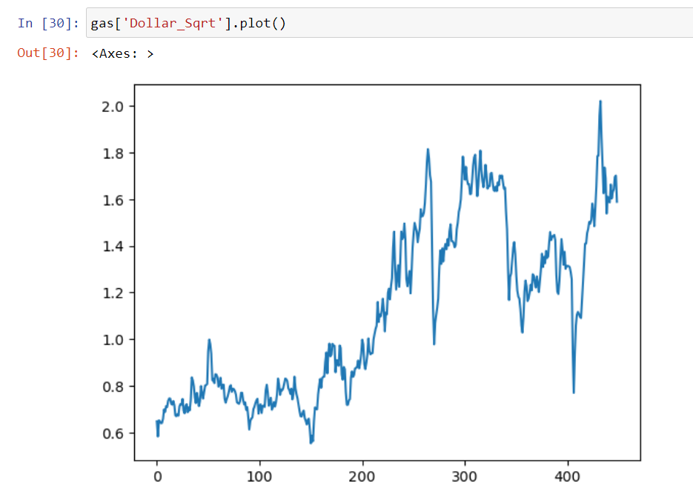
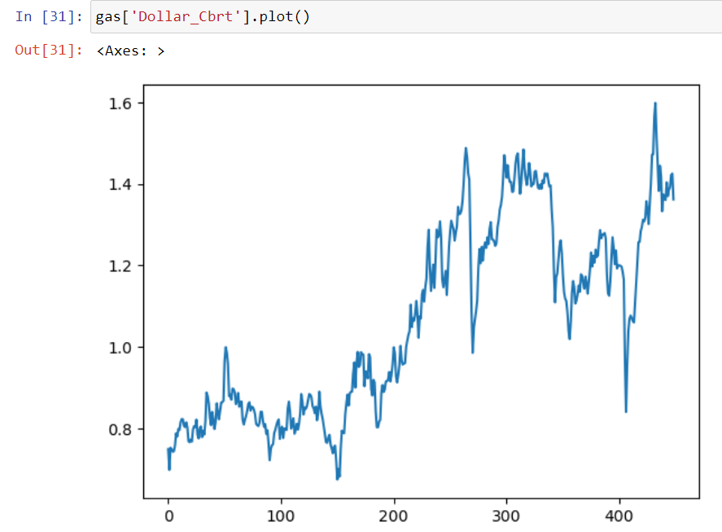
Feature Engineering
Transformations
P = 0.41
P = 0.56
P = 0.39
After applying various transformations like Log, Square root, Cube root, the p-values did not give desired results. Hence we are going for other technique Differencing

Slide 15
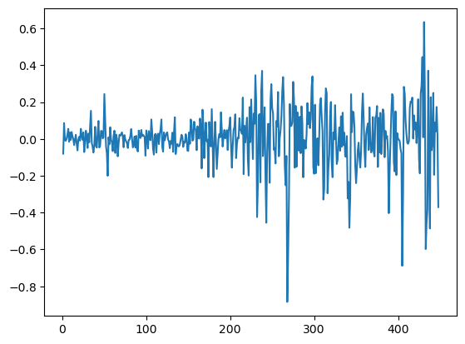
Feature Engineering
Differencing
P = 1.8638484312265997e-11
From the ADF test we can say that the time series is likely stationary, which is an essential requirement for many time series analysis and modeling techniques.

Slide 16
Model Building

Slide 17
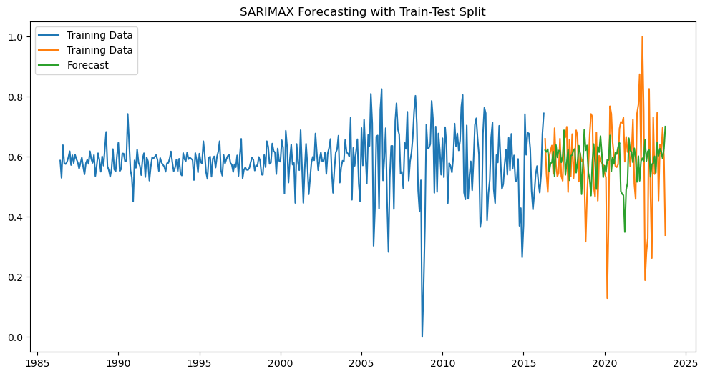
SARIMAX
Split Data in 80% Train and 20% Test
By using SARIMAX(X_train, order=(1, 1, 1), seasonal_order=(2, 1, 1, 75)) parameters, we have achieved more accurate
RMSE : 0.1630
MAPE : 25.4331

Slide 18
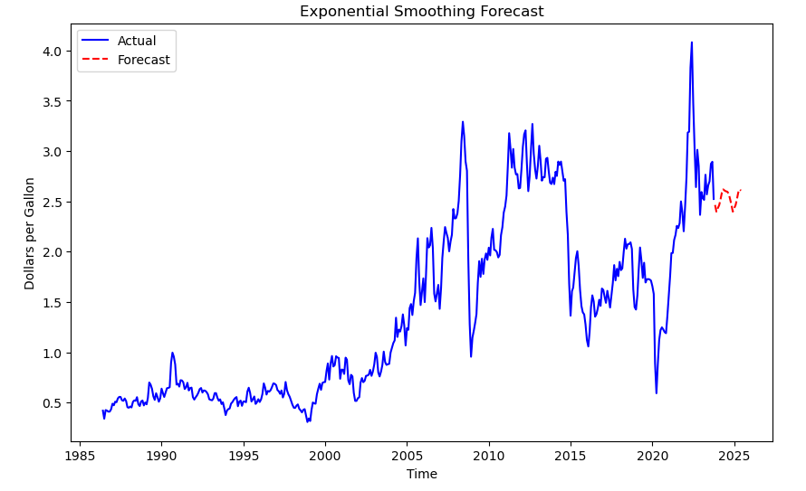
Exponential Smoothing
By using Holt-winters ExponentialSmoothing(endog_series, seasonal='add', seasonal_periods=12) parameters, we have data more accurate
RMSE : 1.45
MAPE : NaN%

Slide 19
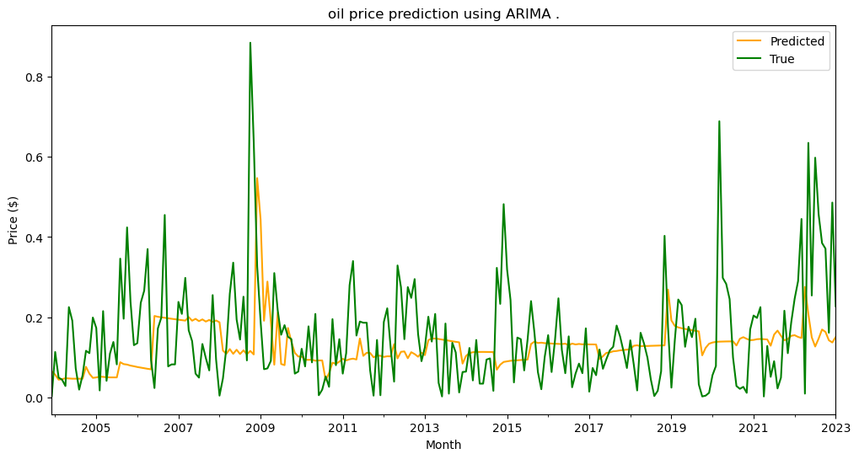
Auto-ARIMA
Split Data in 80% Train and 20% Test
we have achieved more accurate
RMSE : 0.121297
MSE : 0.019448

Slide 20
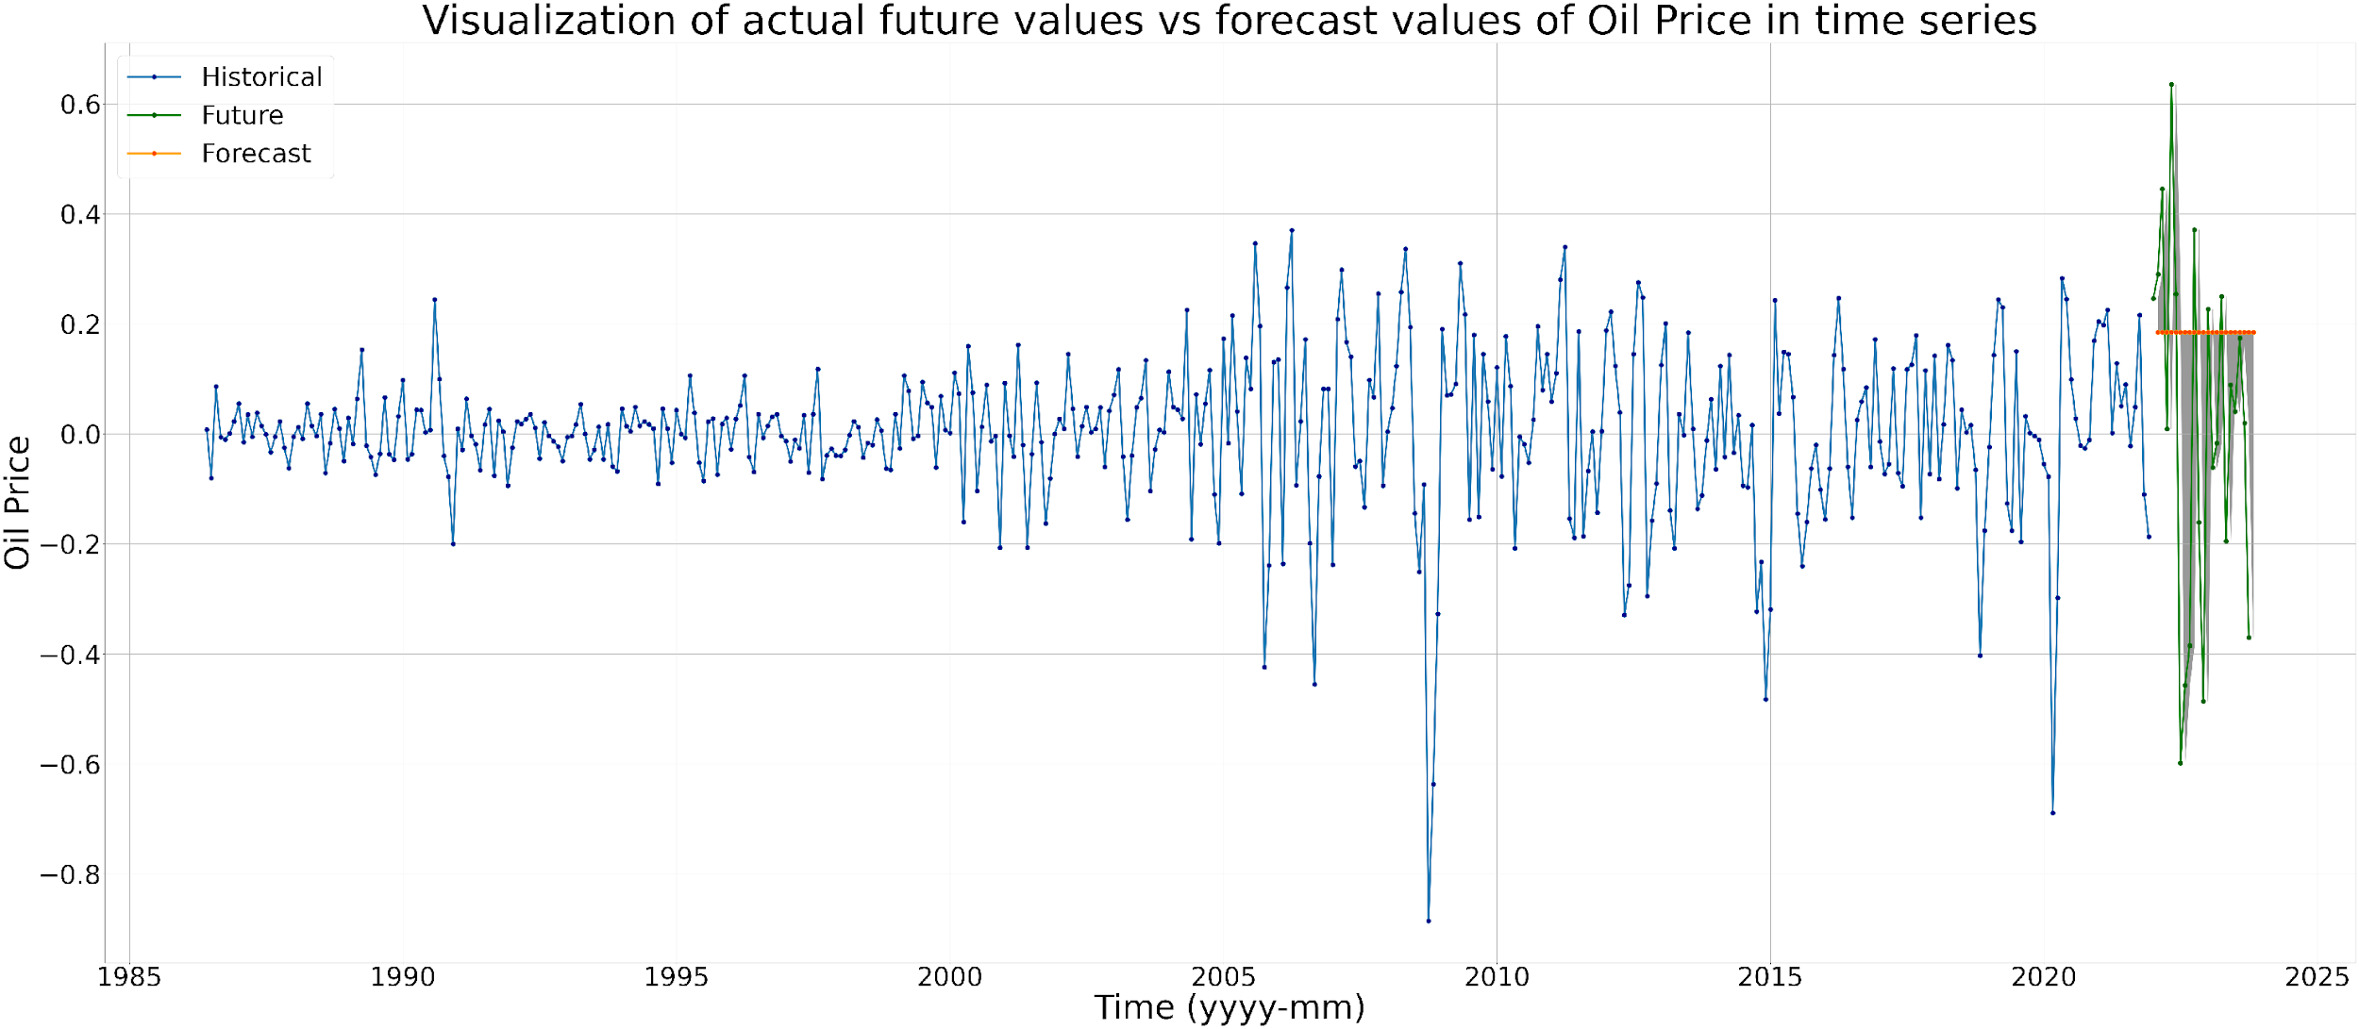
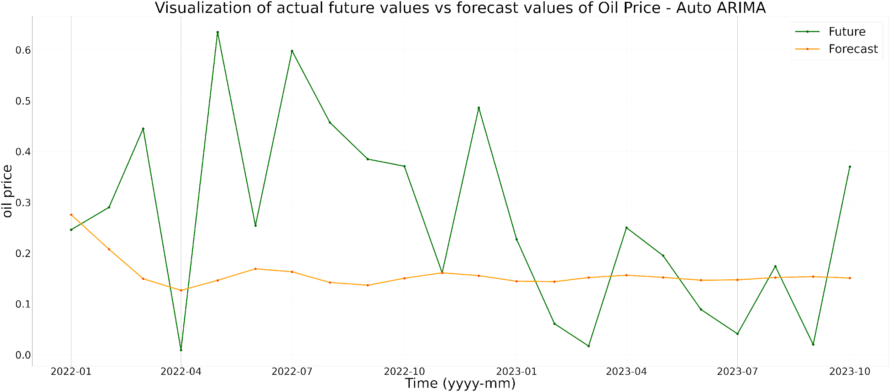

Slide 21
FB Prophet
Prophet is basically a library build by facebook which helps us to
forecast time series data.
By using Prophet,
m = Prophet()
m.fit(train)
future = m.make_future_dataframe(periods=365)
forecast = m.predict(future)
Thus by using prophet model , we have achieved more accurate
RMSE value .
RMSE = 0.37

Slide 22
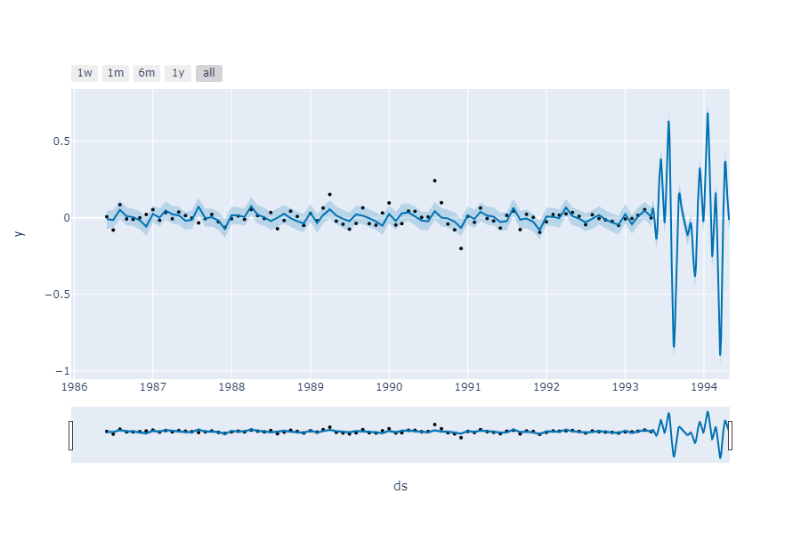
FB Prophet
USING BUILT-IN PROPHET VISUALIZATION :
plot_plotly(m ,forecast)

Slide 23
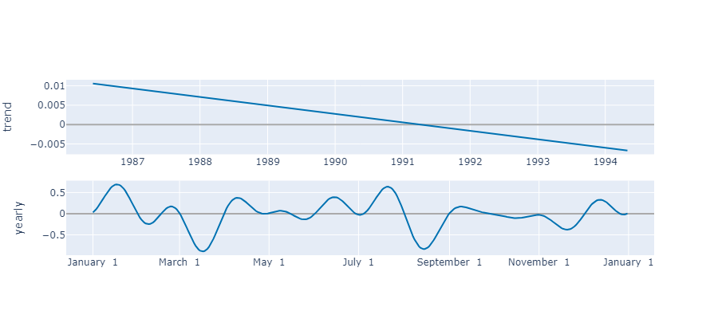
FB Prophet
USING BUILT-IN PROPHET VISUALIZATION :
plot_components_plotly(m, forecast)

Slide 24
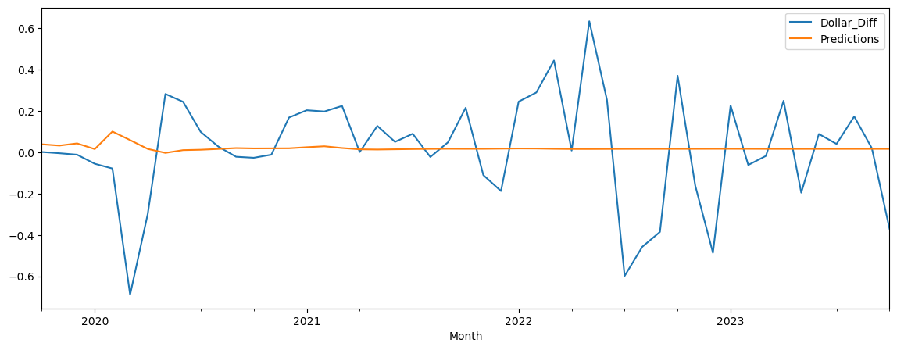
LSTM-RNN
Split Data in 70% Train and 30% Test
RMSE : 0.26138
MSE : 0.019448

Slide 25
Model Predictions

Slide 26
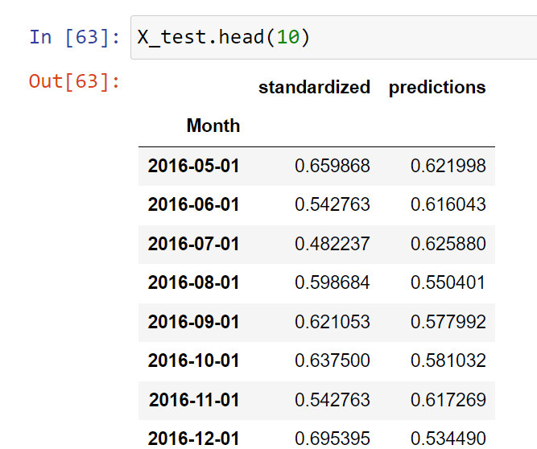
SARIMAX

Slide 27
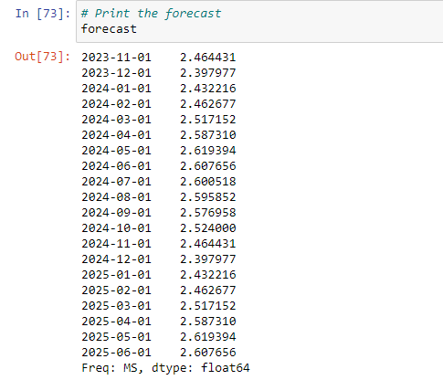
Exponential Smoothing

Slide 28
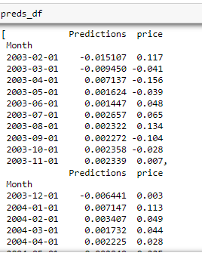
Auto-ARIMAX

Slide 29
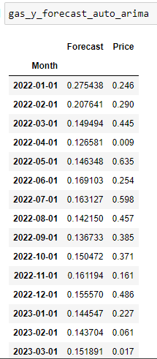
Forecast

Slide 30
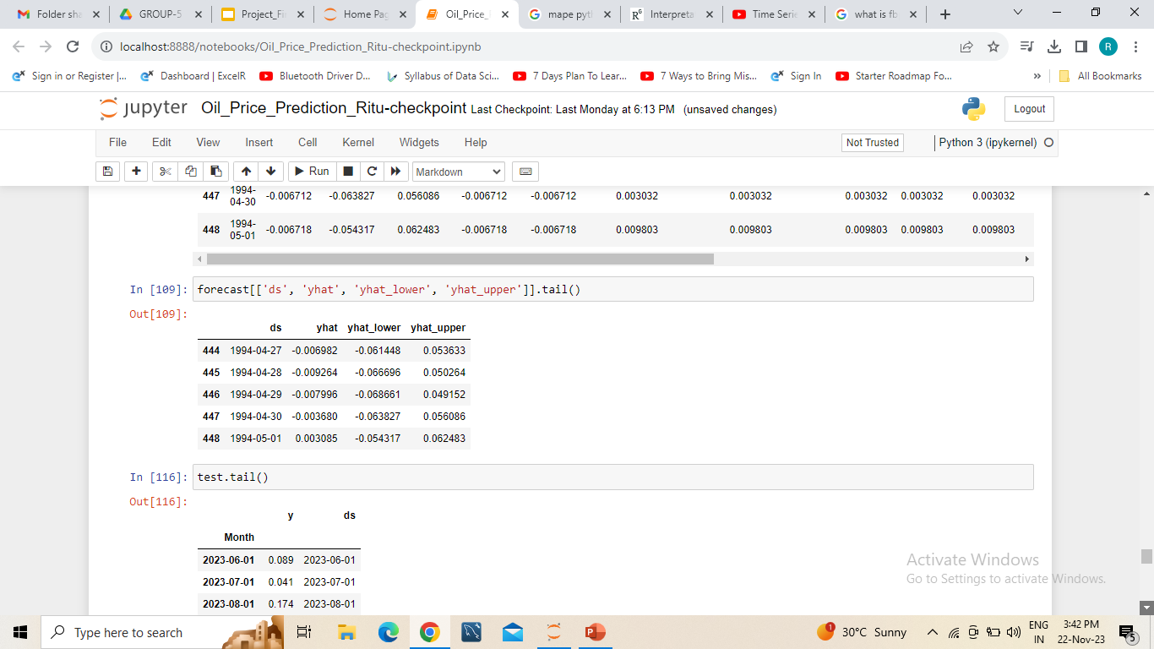
FB Prophet

Slide 31
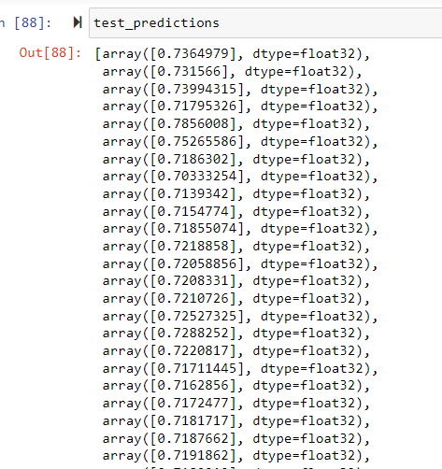
LSTM-RNN

Slide 32
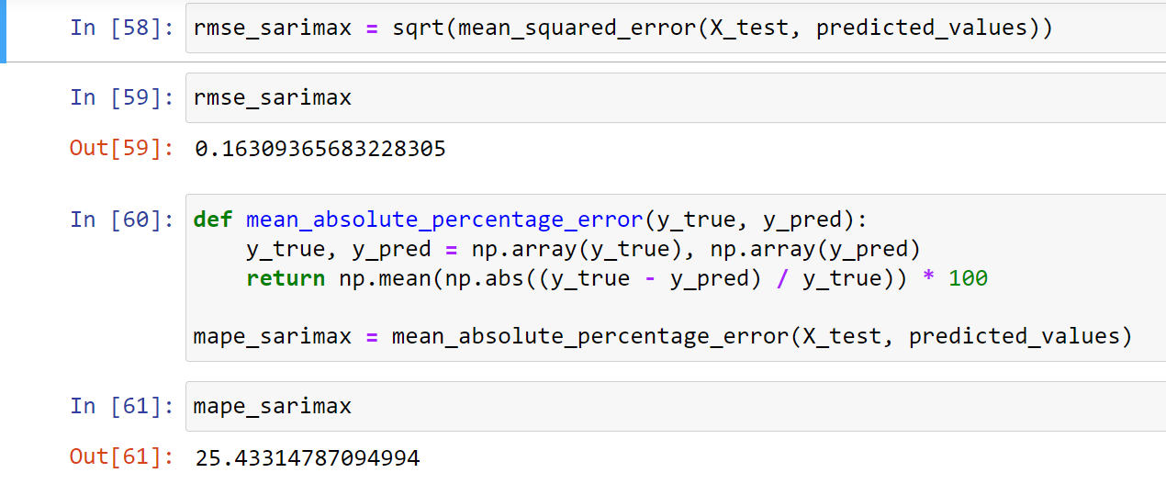
Model Results
Split Data in 70% Train Model has RMSE value of 0.16 and MAPE value of 25.44

Slide 33
Model Deployment

Slide 34
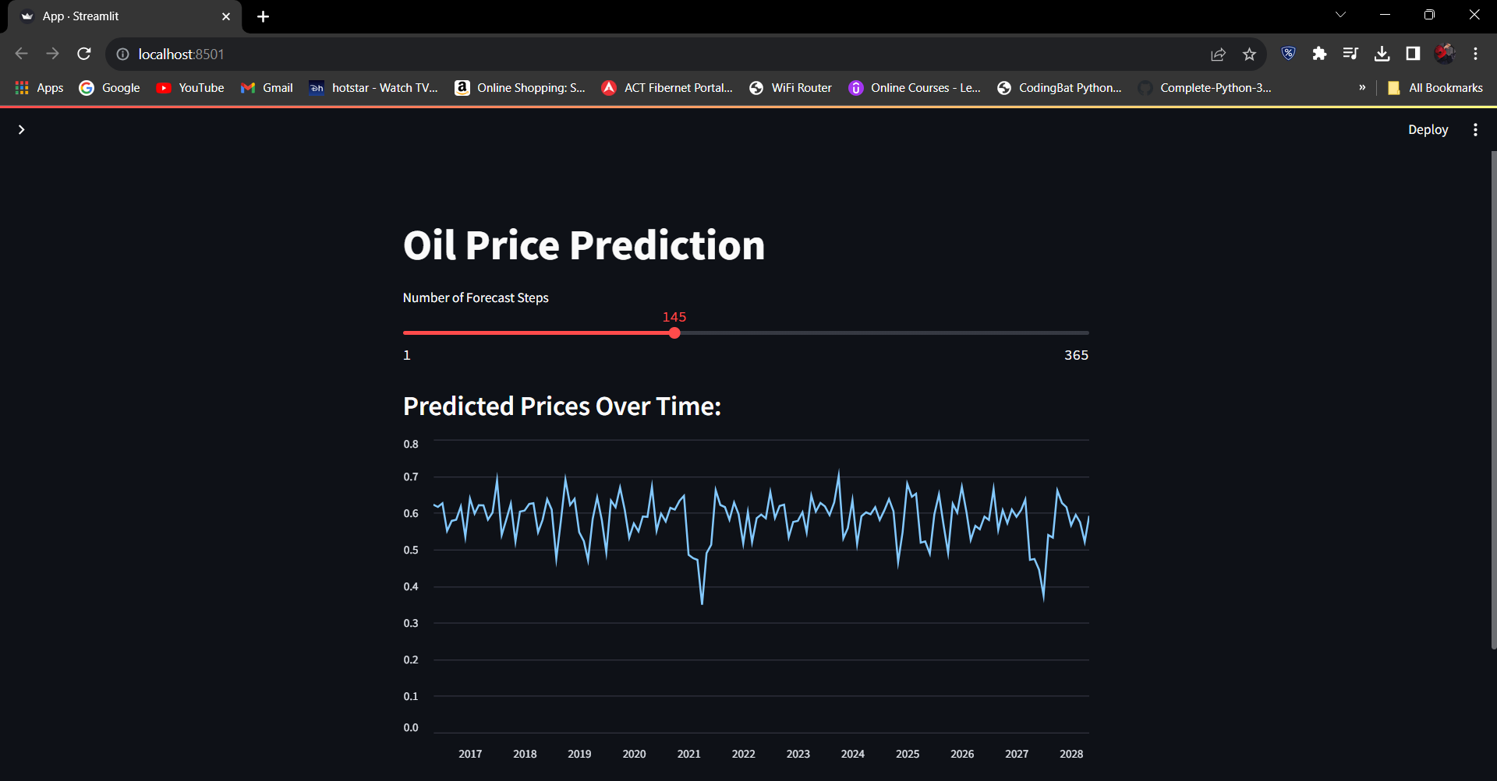
Deployment Using Streamlit

Slide 35
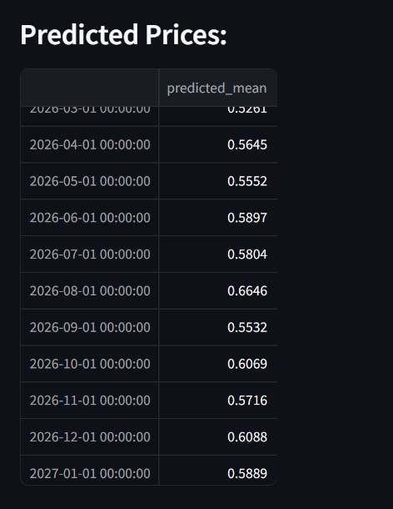

Slide 36
Challenges Faced

Slide 37
Challenges Faced | Solution
We had problem with Date column in the dataset with some information of the dataset in the first five rows. | We have used SkipRows attribute in pd.read_csv function
During EDA, we have faced data being Non-Stationarity | We have overcame Non-Stationarity issue by using Differencing technique
Time series data exhibited seasonality/long-term trends. | Implemented SARIMAX model for this problem
For Plotting Heatmap month vs year we needed month or year column | Separated Month and Year into Column for Visualization and removing meaningful insight of the data
For analyzing the monthly variation in price | We have plotted Box Plot by Monthly Intervals
For predicting future values based on past values | Auto ARIMA (Auto-Regressive Integrated Moving Average) is a statistical algorithm used for time series forecasting. It automatically determines the optimal parameters for an ARIMA model, such as the order of differencing, autoregressive (AR) terms, and moving average (MA) terms

Slide 38
Thank you

